Slide 1
Packet Loss Event Classification
Group H:
Xinyu Liu
Haonan Jian
Zhaoheng Huang
Prof. Francesco Musumeci
Network Data Analysis Laboratory
A.Y. 2024/25

Slide 2
Introduction
- SD-WAN interconnects remote company sites via public Internet links (Fiber & 4G).
- Different links → different performance paths (latency, reliability...).
- Mission-critical applications require low packet loss and stable latency.
Background
- Packet loss or latency spikes may degrade QoS, causing service or financial impact.
- Traditional routing is reactive—only acts after degradation occurs.
Problem
- Classify packet loss events using two ML models: Neural Network & XGBoost
- Explore feature importance
- Experiment with different N and X parameters
- Apply Federated Learning
Objective

Slide 3
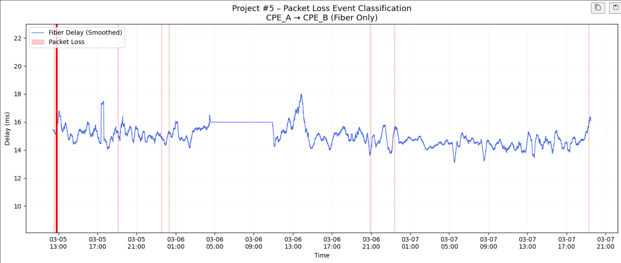
Raw data visualization
Visualizing Delay and Packet Loss Over Time
We visualized time-series delay patterns from SD-WAN links (Fiber and 4G) to explore their correlation with packet loss:
Fiber links show stable low-latency behavior with rare and isolated loss events.
4G links exhibit large fluctuations in delay, with packet loss frequently following sudden delay spikes.
To highlight these patterns, we applied a 1000-point rolling average to smooth delay data and used
Red "X" markers to indicate loss events in case of 4G
Red vertical line feasible region in case of Fiber
This contrast clearly illustrates why 4G packet loss is more predictable, while fiber losses are more challenging for machine learning models.
Next Page will magnify this Pic

Slide 4

Raw data visualization
Figure 1: Fiber Link (CPE_A → CPE_B)
Delay is generally stable and low (14–16 ms range)
Only a few isolated packet loss events (marked in red)
No clear burst pattern — mostly one-off loss
Fiber links show no such pattern—delay remains consistently low, and packet loss events are rare and scattered, indicating no observable correlation

Slide 5
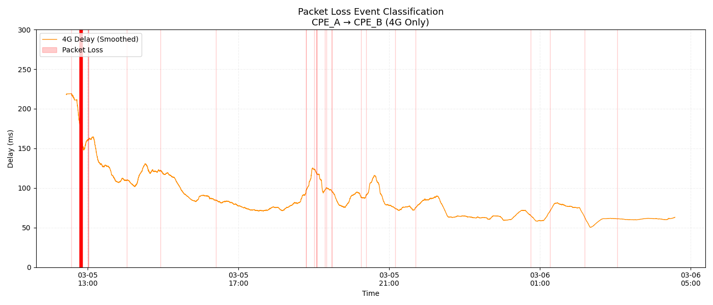
Raw data visualization
Figure 2: 4G Link (CPE_A → CPE_B)
Delay fluctuates more widely (50–200 ms range)
Frequent and clustered packet loss events (red crosses)
Loss events often follow sudden delay spikes
Stronger temporal patterns between delay spikes and loss, making 4G links easier to model and predict than fiber

Slide 6
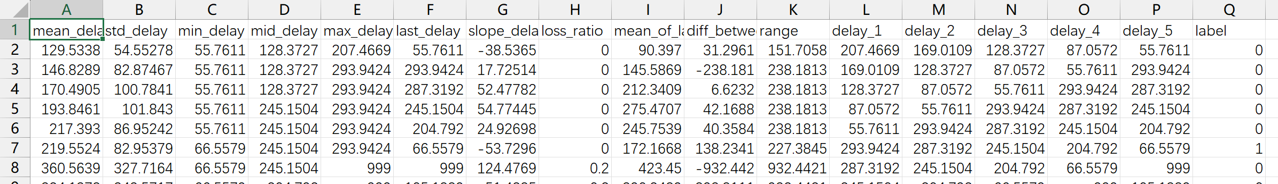
Data preprocessing
In data_process.py
The row with delay_ms == -1 is marked as packet_loss = 1
Set delay_ms to 999 for these lines
Generate a sliding window based on N (Lookback Window) and X (Pred. Window)
For each Lookback Window statistical features are following:
mean_delay slope_delay max_delay
std_delay loss_ratio range
min_delay mean_of_last_three last_delay
mid_delay diff_between_last_two ALL orignal delay

Slide 7
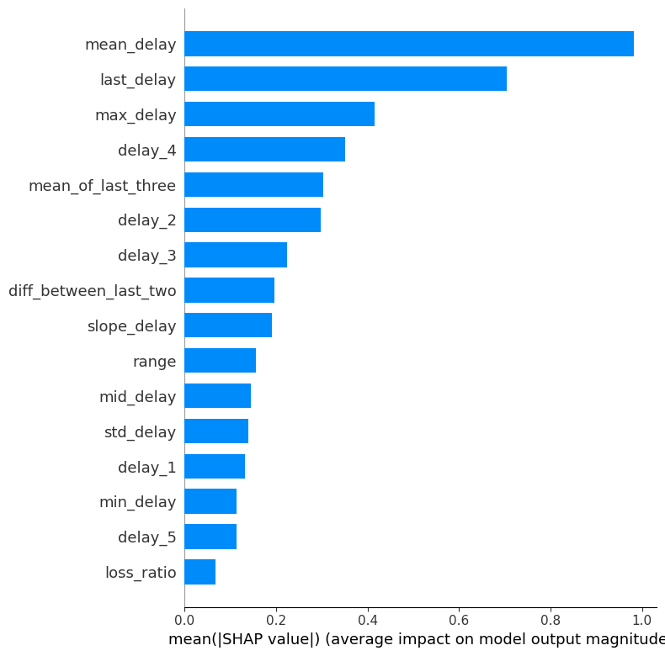
Feature Importance
We can use shap to evaluate the importance of each feature after the model prediction.
Features such as mean_delay, last_delay, max_delay are very important
loss_ratio has low importance and is therefore removed in subsequent training.
The example uses Lookback = 5, so it can be found that the features close to packet loss are more important, so some related features are added separately, such as mean_of_last_three and diff_between_last_two
delay_5 will be deleted because it is the same as last_delay

Slide 8
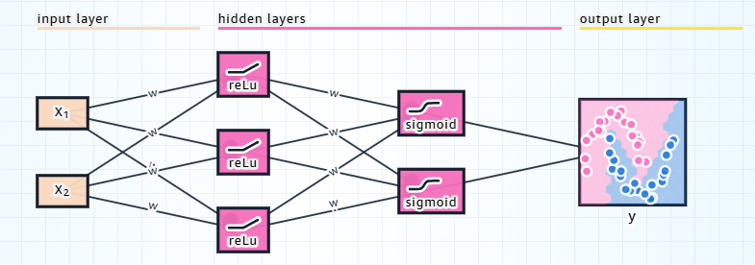
Neural Network - Architecture
A neural network architecture consists of three layer types:
input layer: A layer with a node for each network input.
hidden layer(s): A layer full of artificial neurons.
output layer: A layer representing the network's output.

Slide 9
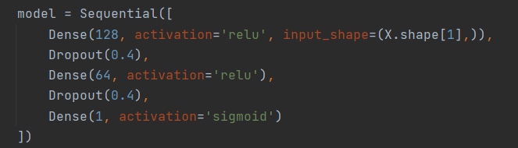
Neural Network - Active Function
1. ReLU (Rectified Linear Unit) in Hidden Layers
Input features are numerical (statistical delay metrics) ---> apply non-linear transformations to extract meaningful patterns
ReLU (Rectified Linear Unit) is a standard choice because:
- Fast and efficient to compute
- Helps avoid vanishing gradients
- Allows the network to learn nonlinear relationships like “if delay spike + high variance → likely packet loss”
features extracted from a sliding window, ReLU helps the model capture non-linear causal patterns: Certain delay behaviors → likely packet loss in the near future.

Slide 10
Neural Network - Active Function
2. Sigmoid in Output Layer
To solve a binary classification problem: 0 = no packet loss ; 1 = packet loss
sigmoid compresses the output to the range [0, 1], which can be interpreted as the probability of packet loss. e.g., Output of 0.91 → high risk of packet loss
This enables to set a decision threshold (like 0.5) to decide when to take action.
3. why Dropout
Dropout prevents overfitting, which is important since your dataset is likely limited to a few hours/days of real-world network measurements.
It helps the model generalize better to new unseen traffic patterns.

Slide 11
Neural Network - Code Logic Flow
Set Parameters (LOOKBACK=20s, PREDICT=3s)
↓
Load and Merge all data & remove header rows
↓
Prepare features (X) and labels (y = future loss)
↓
Scale features (StandardScaler)
↓
Split data (train/val) with class balance (stratify)
↓
Handle class imbalance (boost weight of positive class ×1.5 → recall↑)
↓
Build model (Dense–ReLU–Dropout–Sigmoid)
↓
Train model (Adam optimizer + EarlyStopping)
↓
Predict on validation set (probabilities)
↓
Tune decision threshold (use PR curve to maximize recall )
↓
Evaluate model (F1, recall, precision, confusion matrix)

Slide 12
Neural Network - hyperparameter tuning strategy
1. Model Parameter Tuning
Class weighting: weights[1] *= 1.5
This directly comes from the data imbalance (very few label = 1 samples). Increases the penalty for misclassifying the positive class (i.e., packet loss). Makes the model more sensitive to rare packet loss events.
Directly boosts recall by forcing the model to detect more positives.
Threshold Tuning
Instead of using a fixed threshold (0.5), this dynamically chooses one that allows more predictions to be positive within the threhold. Strongly improves recall, especially in imbalanced settings.
batch_size=128
A smaller batch size (e.g., 32) can help the model better adapt to rare class patterns through more frequent gradient updates. Can help recall in imbalanced settings.
learning_rate = 0.0008
A small learning rate is stable, but if recall is lagging, slightly increasing it can help the model better adjust its decision boundary. Helpful for recall through faster adaptation during training.

Slide 13
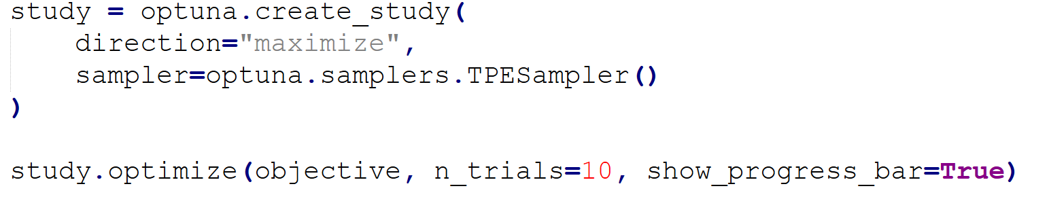
XGBoost
In xgboost_combine.py
It iterates over the previously generated files and runs the model for each pair of N X values
The code uses Bayesian optimization and cross validation with KFold=5.
Packet loss prediction is a highly imbalanced classification task.
Grid search is inefficient; Bayesian tuning finds better hyperparameters faster.

Slide 14
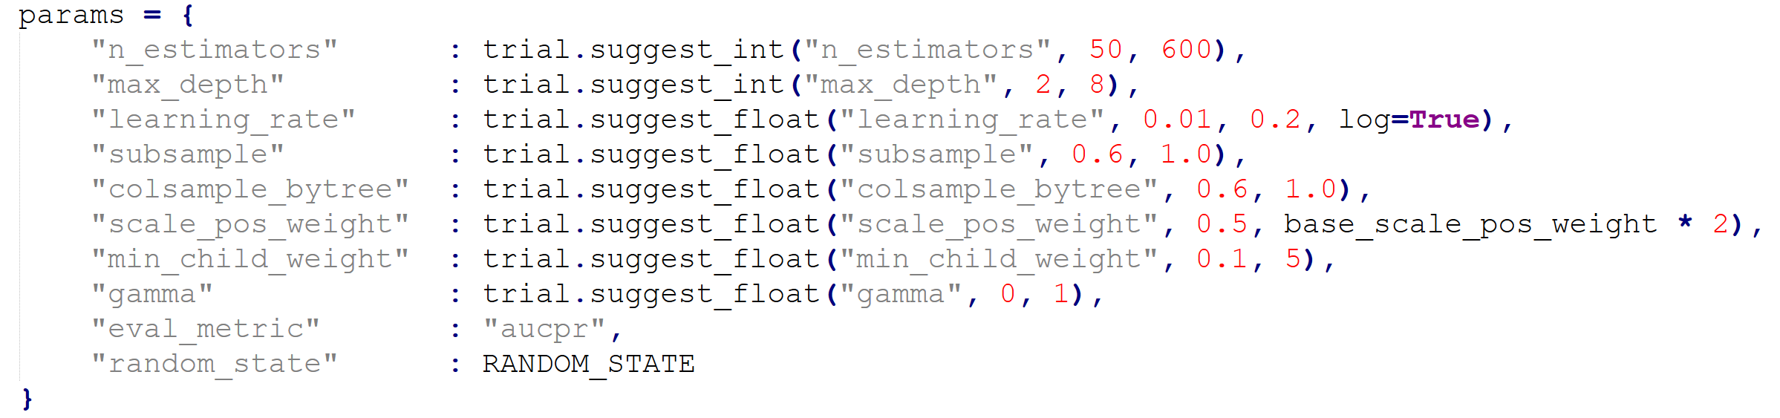
XGBoost
Considering that the data set of the packet loss prediction model is an extremely imbalanced data set with positive values, the parameter range of Bayesian optimization is:
base_scale_pos_weight is the ratio of positive to negative values

Slide 15
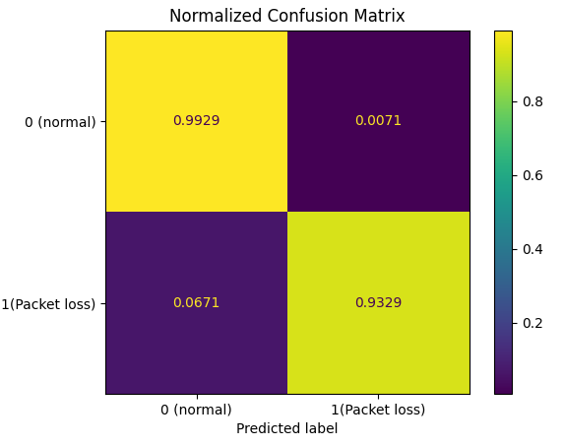
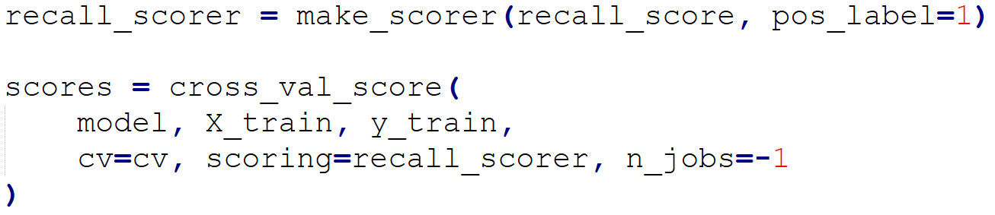
Performance
For packet loss prediction models, Accuracy is almost meaningless (always stays at 99%)
Other parameters include Recall (missed detection), Precision (false detection), F1 Score
Since the task description requires strict QoS and the performance cost caused by false detection is not too high, we mainly choose Recall as the evaluation parameter*.
The recall is about 0.9
and the precision is about 0.3.
*Congestion or No Congestion: Packet Loss Identification and Prediction Using Machine Learning

Slide 16
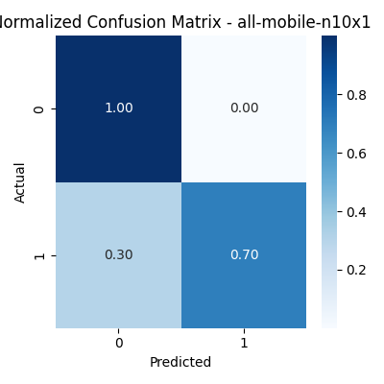
If you increase precision
If the precision limit is increased, the recall will be reduced. The specific choice depends on the requirements.

Slide 17
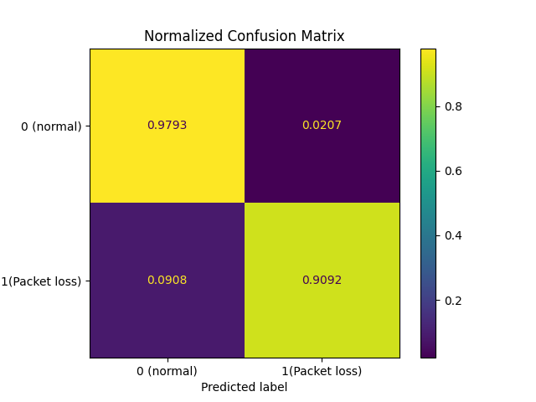
If you use both Fiber and Mobile links
recall = 0.91 precision = 0.065
It can be found that if fiber and mobile are used at the same time, the precision will decrease.

Slide 18
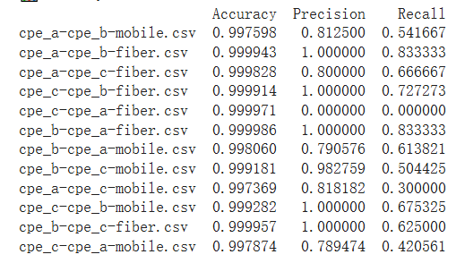
Results of a single link
It can be found that the recall of some links is very low. The cpe_c-cpe_a-fiber link has only 8 packet losses in total, and only 1 packet loss in the split test set, resulting in both precision and recall being 0.

Slide 19
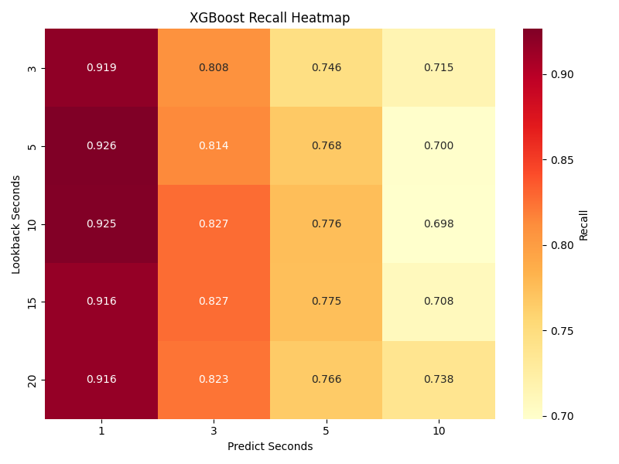
N & X Parameters Experimentation
In general, as the Predict Window increases, the Recall gradually decreases.
As the Lookback Window increases, Recall increases first and then decreases, but the overall change is not significant.
Therefore, when we select the Window value, we can choose a smaller Predict Window, and the Lookback Window value is recommended to be around 5s, because a higher Lookback Window value will increase the overhead.
XGBoost

Slide 20
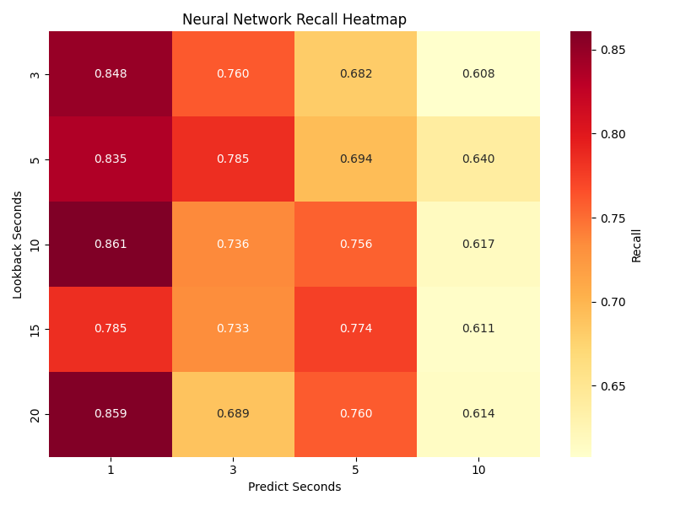
Performance Comparison
XGBoost
Neural Network
XGBoost is often better than Neural Networks

Slide 21
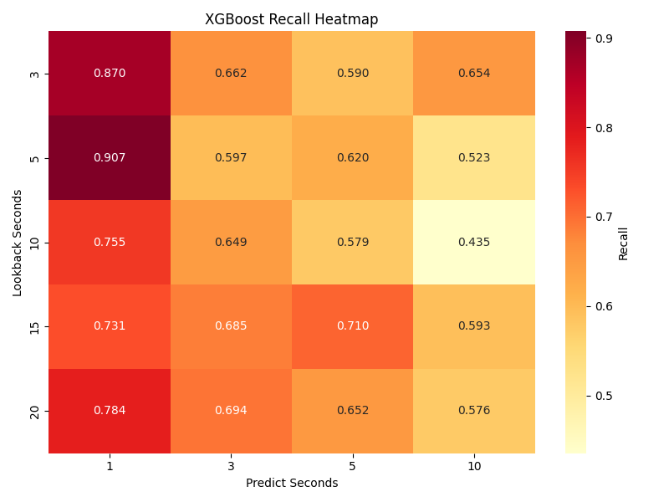
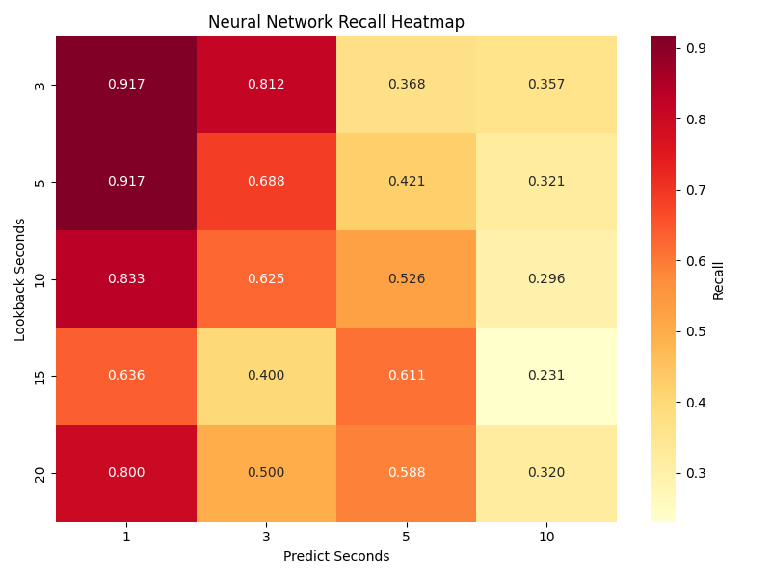
Performance Comparison
XGBoost
Neural Network
Since fiber packet loss is small, the model effect is usually poor. Even if the recall is high, it is based on sacrificing precision.

Slide 22
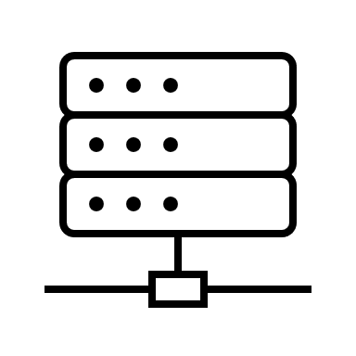

Federated Learning - Basics
First, each CPE local data is trained independently to obtain a model
The controller then aggregates these local models to generate a global model that integrates the learning results of all participating devices.
After that, the controller sends the updated global model back to each CPE
SD-WAN Controller
CPE-C
CPE-A
CPE-B

Slide 23
Federated Learning - Neural Network
In nn_fl.py
For a single CEP-A, only the dataset of Ping packets sent by CEP itself is trained.
Save the scaler of your own neural network model
Save itself model
In nn_fl_controller.py
Simulate model aggregation in SD-WAN Controller and generate a new federated learning model
Federated Learning of Neural Networks with FedAvg
Load all model paths
Load the weight list and Aggregation weight
Build a new model with the same structure as the original model
In nn_model_load.py
Read the corresponding model and scaler

Slide 24
Federated Learning - XGBoost
In xgboost_fl.py
In xgboost_fl_controller.py
Federated Learning of XBGoost with soft voting aggregation model
Use joblib to load model
Build a soft voting aggregation model
In xgboost_model_load.py

Slide 25
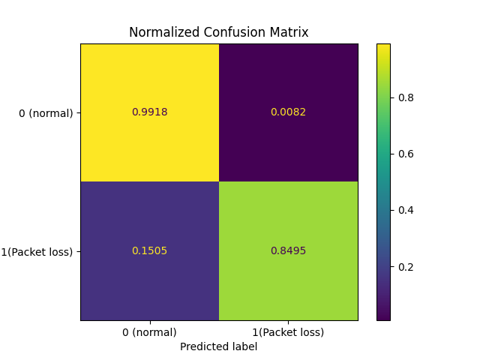
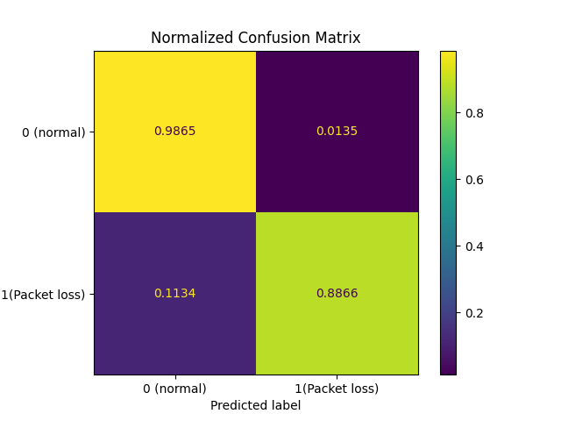
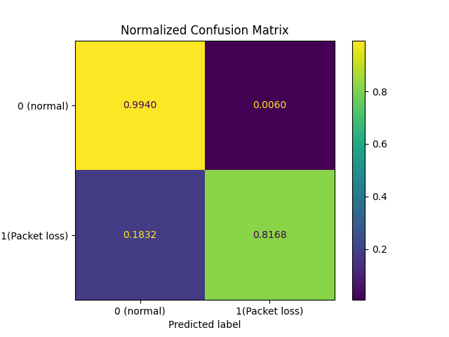
Federated Learning - Performance - XGBoost
Select the first capture as the training set and the second as the test set
Choose N=5, X=1 as the Window
We use XGBoost and neural network methods to compare the models in three cases:
Local: The local model of CEP
Fed: federated model that each CEP integrates
All: general model trained on all datasets
CPE-A
CPE-B
CPE-C

Slide 26


Federated Learning - Performance - XGBoost
CPE-B
Fed
Local
All
It can be seen that the accuracy of the All model is the lowest
Local and Fed have similar effects, with Fed having slightly better effect
This is mainly because federated learning can improve the generalization of the mode

Slide 27
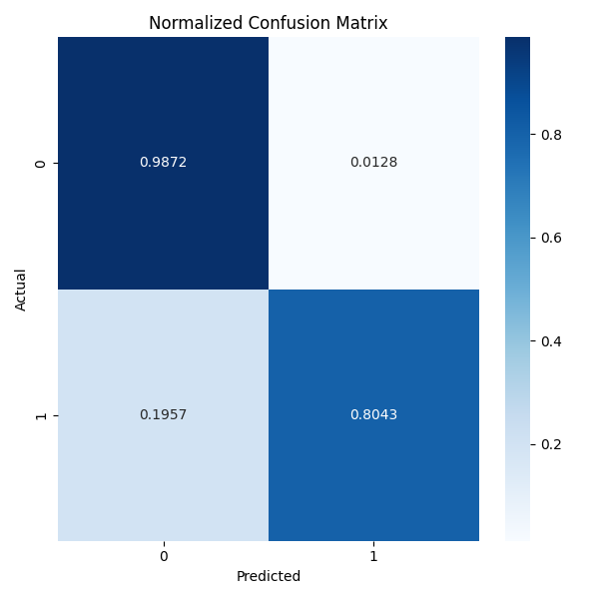


Federated Learning - Performance - Neural Network
CPE-A
Fed
Local
All
In neural networks, federated learning has the worst effect
This may be because the data distribution of each CPE is very different, and the directions learned by each local model are inconsistent.
And the scaler used by each model is inconsistent

Slide 28
Conclusion
We built a machine learning-based pipeline to predict packet loss events in SD-WAN using both Neural Network and XGBoost models.
Feature engineering and visualization revealed clear temporal patterns in 4G links, whereas fiber links were more stable but harder to model.
Due to the class imbalance (few loss events), we emphasized recall as the primary evaluation metric.
XGBoost outperformed Neural Networks in terms of recall and generalization, especially on imbalanced datasets.
Federated Learning further enabled local training on each CPE with improved generalization in XGBoost, though performance dropped in Neural Networks due to inconsistent data distribution and scalers.

Slide 29
Future Improvement
Improve Precision: Integrate cost-sensitive learning or focal loss to reduce false positives while maintaining high recall.
Temporal Feature Engineering: Introduce more advanced time-series features (e.g., delay change rate trends, peak detection) to capture richer temporal dynamics.
Model Fusion: Combine the strengths of XGBoost and Neural Network models through ensemble techniques for better robustness.
Federated Normalization: Explore federated feature scaling techniques (e.g., FedBN) to align feature distributions across devices and enhance NN performance in FL.
Expand Dataset: Include longer monitoring periods or other CPEs to improve model training, reduce overfitting, and capture more diverse loss patterns.
Deployability: Package the best-performing model into a lightweight inference module suitable for real-time SD-WAN edge deployment.

Slide 30
Thank you for your attention!

